Slide 1

Probability Distribution
By

Slide 2


Types of Probability Distributions
Dice
Card
Finite numbers of outcomes
Discrete Distribution

Slide 3

Types of Probability Distributions
Time
Distance
Infinitely many outcomes
Continuous Distribution

Slide 4
What’s in it?
THE CHARACTERISTICS OF THE MOST COMMON DISTRIBUTIONS
Important Aspects
Use Cases

Slide 5


Discrete Distribution
Cards
Coin
All outcomes are equally likely
Equiprobable
Uniform Distribution

Slide 6

DISCRETE UNIFORM DISTRIBUTION
Think about a fair die.It has six sides, numbered from 1 to 6. Imagine that we roll the die. What is the probability of getting 1?

Slide 7
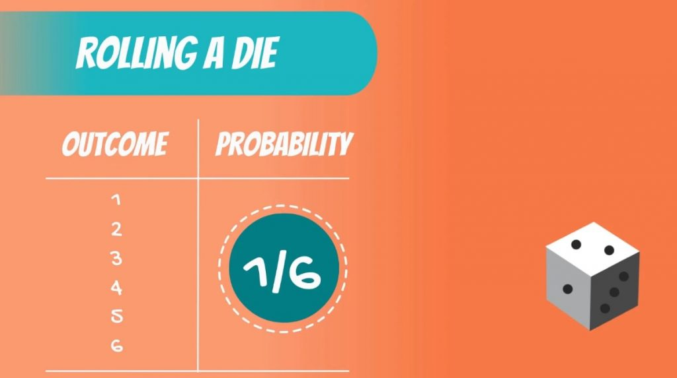

Slide 8


Discrete Distribution
Events with only two possible outcomes
True
False
Bernoulli Distribution

Slide 9

Bernoulli Distribution
3 Girls
FALSE
7 Boys
TRUE

Slide 10
Discrete Distribution
Binomial Distribution
Two outcomes per iteration
Multiple iteration

Slide 11
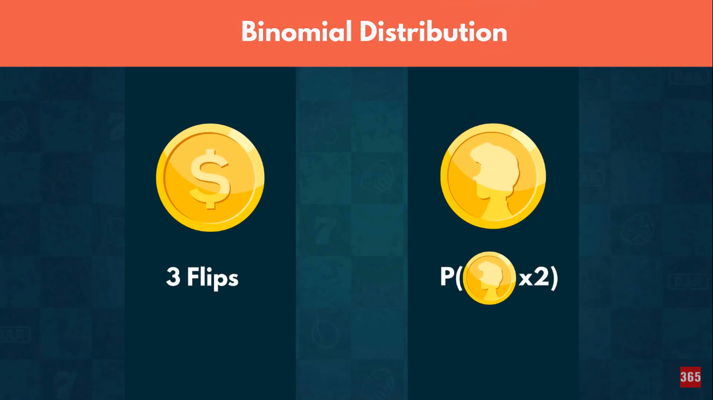

Slide 12
Discrete Distribution
Poisson Distribution
Used to model the number of events occurring within a given time interval.

Slide 13
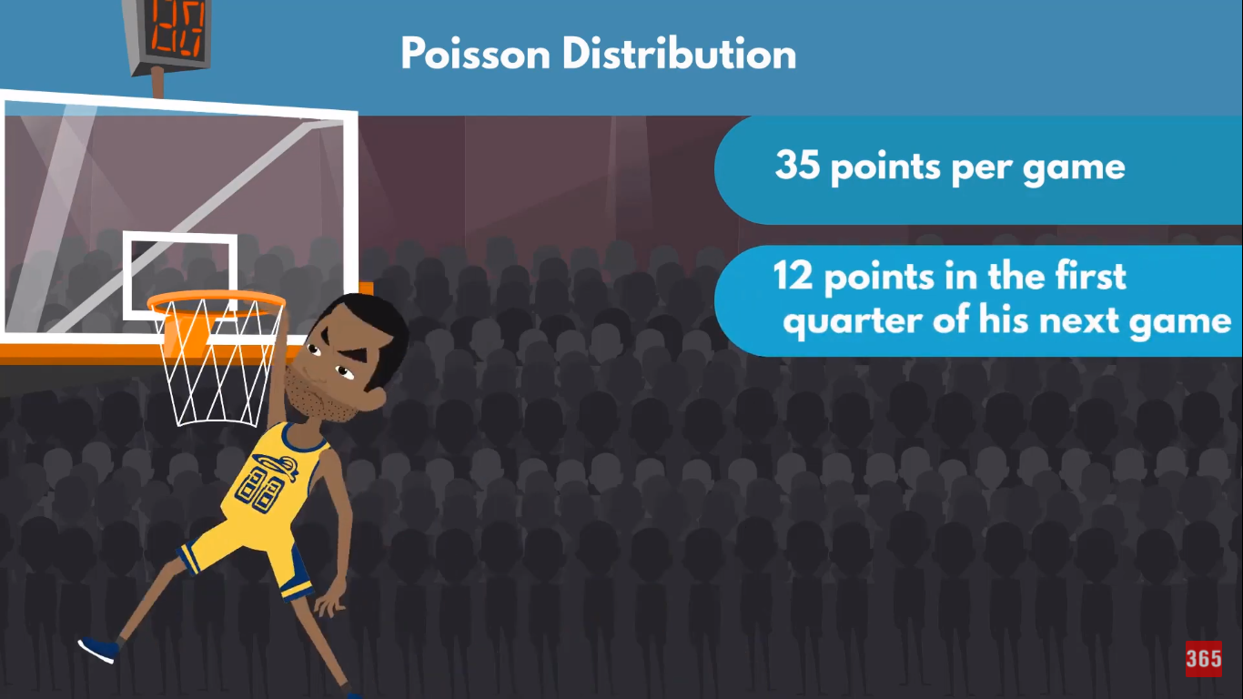

Slide 14
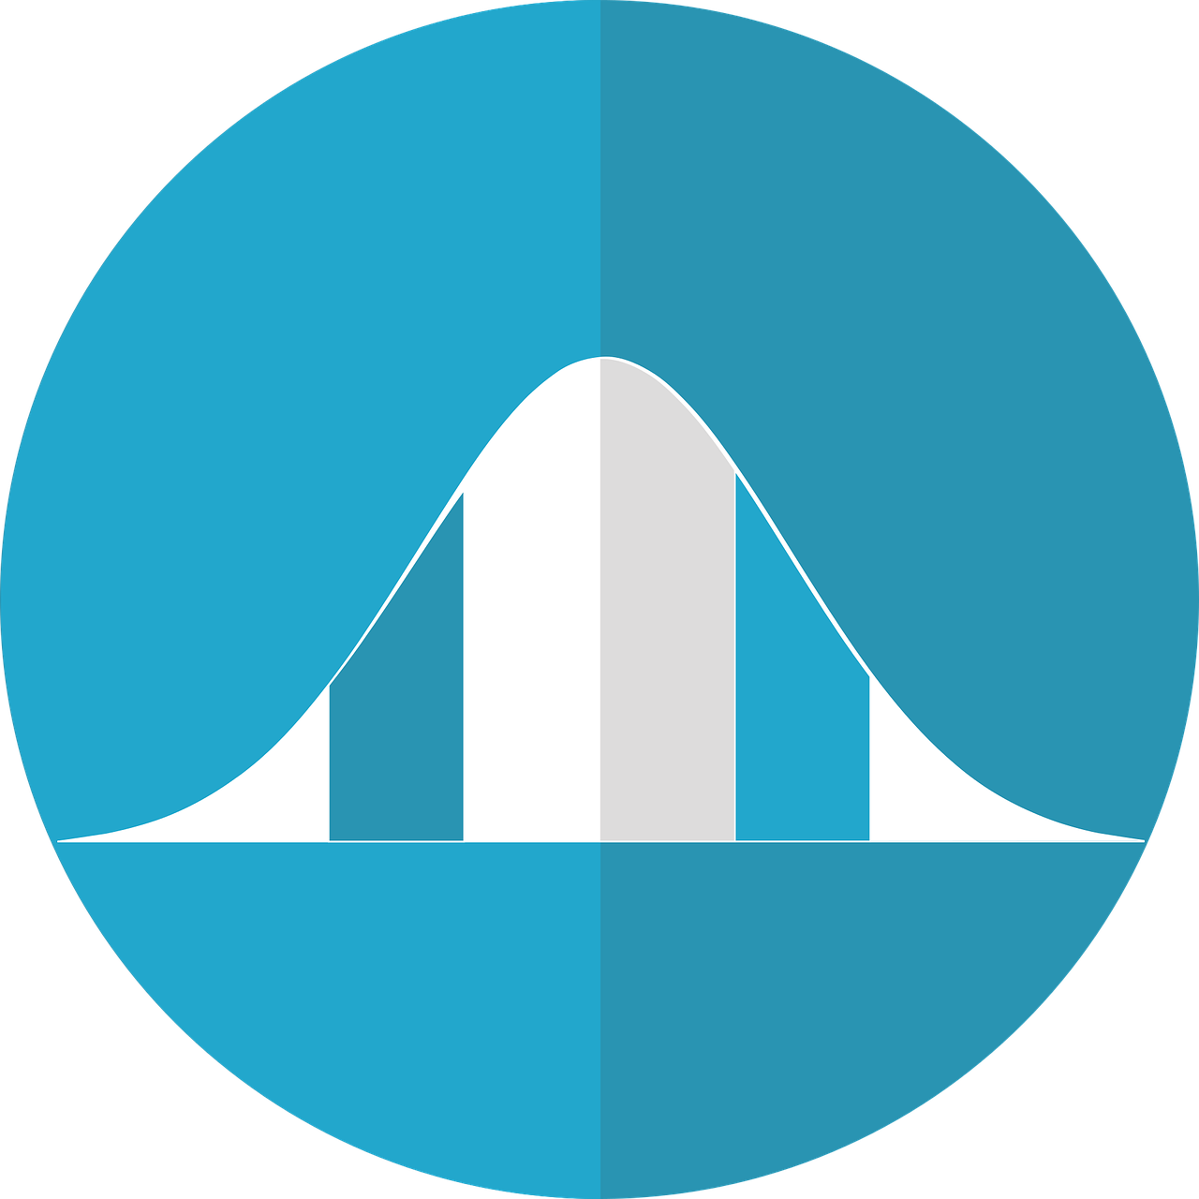
Continuous Distribution
Normal Distribution
Normal/Gaussian Distribution is a bell-shaped graph

Slide 15
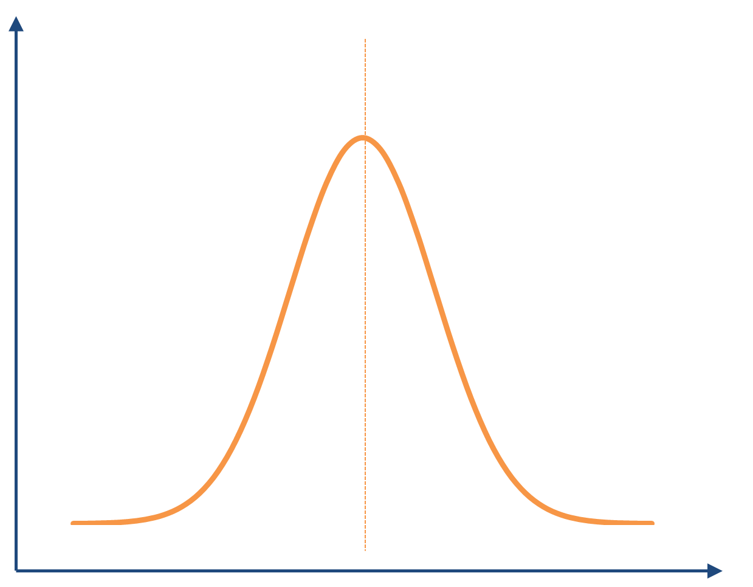

Normal Distribution
Students scoring in an exam
Maximum students score nearly the half of maximum score

Slide 16
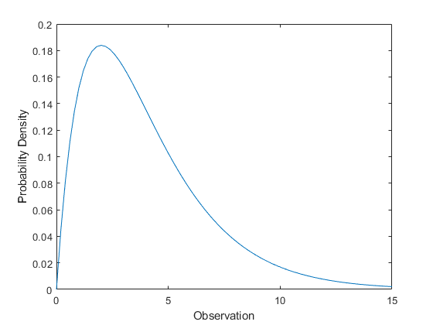
Continuous Distribution
Chi-squared Distribution
Asymmetric
Only consists of non negative values

Slide 17
Chi-squared Distribution
Used in hypothesis testing
Goodness of fit

Slide 18
Continuous Distribution
Exponential Distribution
Events that are rapidly changing early on

Slide 19

Exponential Distribution
Events that are rapidly changing early on
Newly uploaded videos gets views rapidly which goes on slowing down with time

Slide 20
Continuous Distribution
Logistic Distribution
used for modeling growth, and also for logistic regression.
It is symmetrical, unimodal (it has one peak) and is similar in shape to the normal distribution

Slide 21
Logistic Distribution
We may calculate the likelihood of a student passing an exam based upon the number of right answers he gives in the first 20 minutes of an MCQ exam.
Notes:
A credit card company wants to know whether transaction amount and credit score impact the probability of a given transaction being fraudulent. To understand the relationship between these two predictor variables and the probability of a transaction being fraudulent, the company can perform logistic regression.

Slide 22
That’s all for today.
Thank you.

